Slide 1
Use Cases/ Class Diagram
Rewind and start again
The Tricky bits
& pieces

Slide 2
Use Case Diagram
A use (yoos) case describes what the system does, not how it does the work.
The use case model reflects the view of the system of the user outside of the system.
Symbols are:
  Actor, a stick figure.
  Use case, an oval.
  Connecting lines.
Kendall & Kendall
© 2005 Pearson Prentice Hall
18-<number>

Slide 3
UML Use Case Diagram Symbols
Use Case
Actor
Boundary
Connection
Include relationship
Extend relationship
<<include>>
<<extend>>

Slide 4
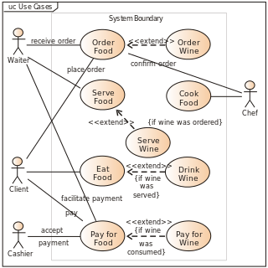
Use Cases
Model a system: the objects and the actions
nouns verbs
actors use-case

Slide 5
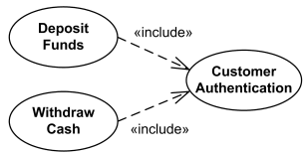
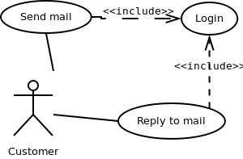
Tricky Bit 1: <<include>>
<<annotations>>
<<are in these angle braces>>
<<no big deal>>
included use case never stands alone. It only occurs as a part of some larger base (use case) that includes it.
We may have a use case to send a mail, but can show that to do this, it includes logging in: the base use case is incomplete without the included use-case
<<include>> used to be called <<uses>> but the meaning is the same

Slide 6
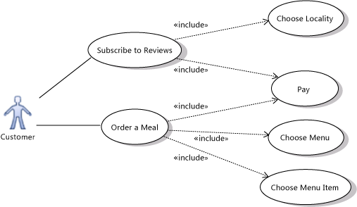
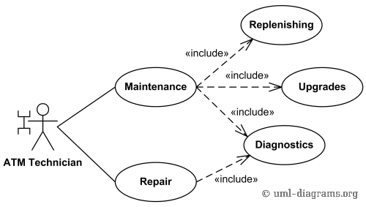
Examples <<include>>

Slide 7
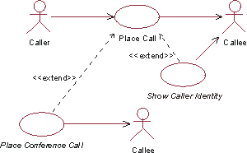
Tricky bit 2: <<extends>>
base use case represents the “must have” functionality of a project while the extending use case represents something optional (should/could/want)
the term optional is relevant – optional whether to build/deliver rather than optional whether it sometimes runs as part of the base use case sequence
What might you use as an extend for a video game such as Pong?

Slide 8
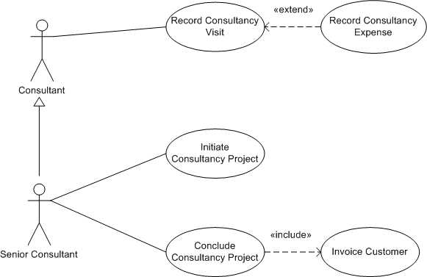
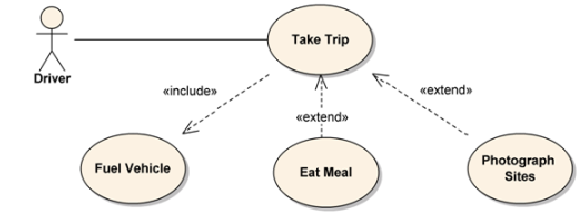

Slide 9
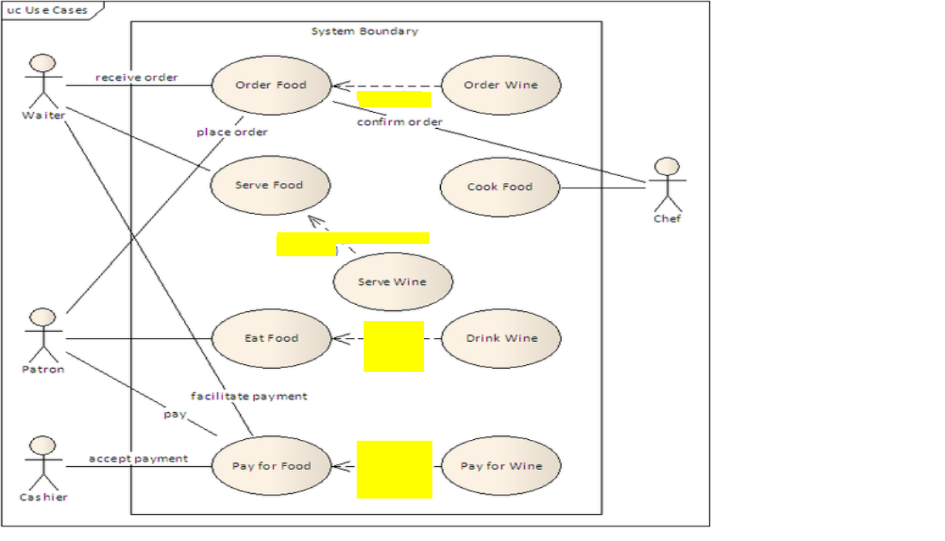

Slide 10
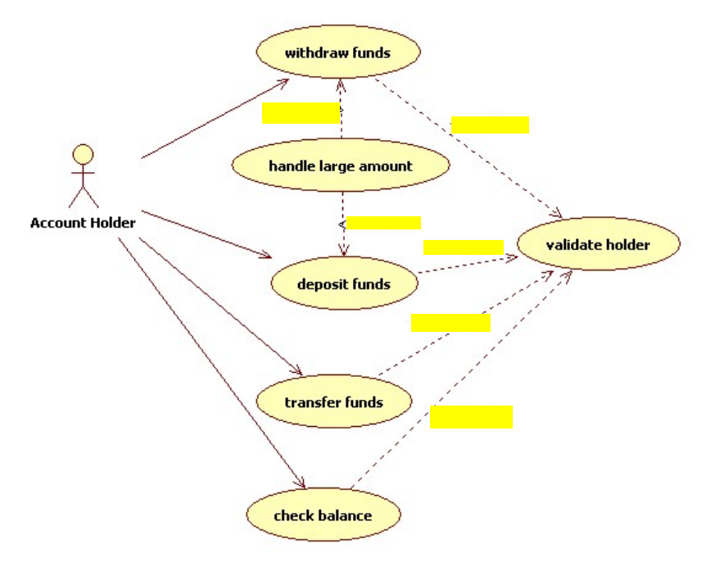

Slide 11
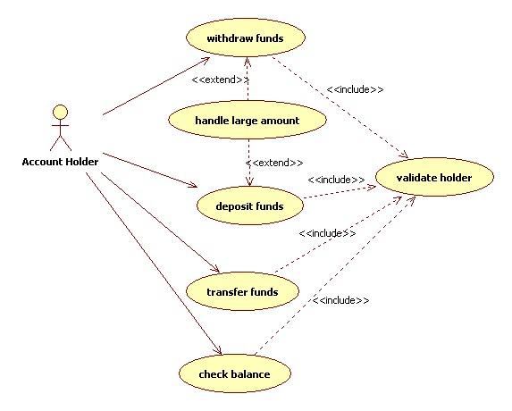

Slide 12
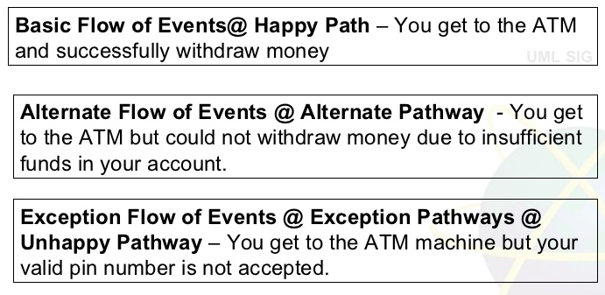
Basic flows in use case
Basic will be on diagram- the others in a table

Slide 13
Alternative or Exceptional
Result negative: An Exception is anything that leads to NOT achieving the use case’s goal. "Cancel transaction" is a typical Exception because it leads to not achieving the use case’s goal.
Result positive: An Alternate Flow is a step or a sequence of steps that achieves the use case’s goal following different steps than described in the main success scenario. But the goal is achieved finally.

Slide 14
An alternate flow describes a scenario other than the basic flow that results in a user completing his or her goal.
It is often considered to be an optional flow and implies that the user has chosen to take an alternative path through the system.
An exception flow is an unintended path through the system usually as a result of missing information or system availability problems.
Exception flows represent an undesirable path to the user but, even though the exception flow has occurred the system will ideally react in a way that recovers the flow and provide some useful information to the user.
The primary benefit of differentiating between alternative flows and exception flows is the focus that exception flows bring to error conditions.
By capturing all of the ways that the system can fail or produce an error, the business analyst can be sure to create a design which mitigates the impact of the error.

Slide 15
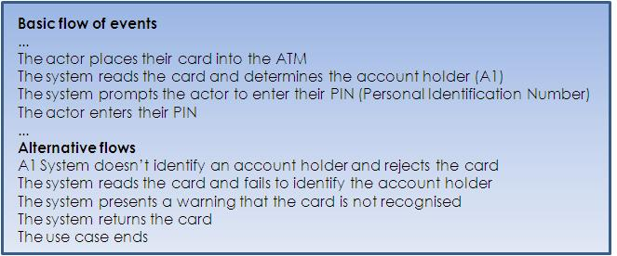
Alternate flow
The "Sliding Doors" of use-cases

Slide 16
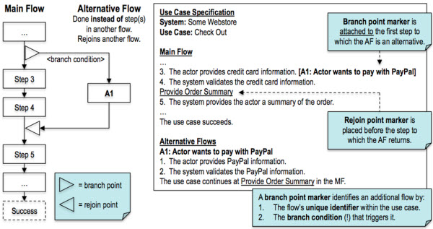
Alternate Flow

Slide 17
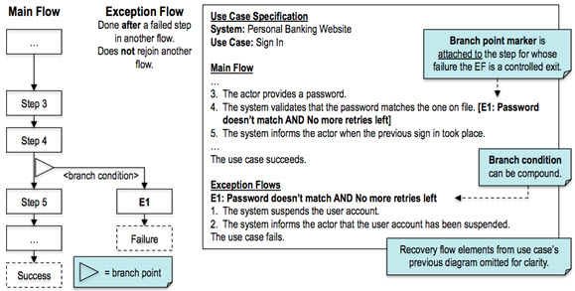
Exceptional Flow

Slide 18
Preconditions
Use cases have these
“[A use case’s preconditions indicate] what the system will ensure is true before letting the use case start.”*
“Generally, a precondition indicates that some other use case has already run to set it up.”

Slide 19
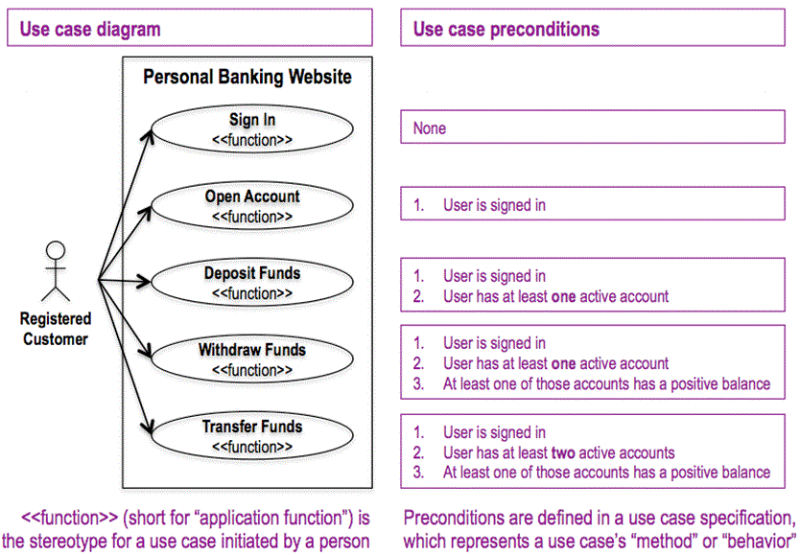

Slide 20
Postconditions
Use cases also have these
must always be true just after the execution of some section of code or after an operation in a formal specification.

Slide 21
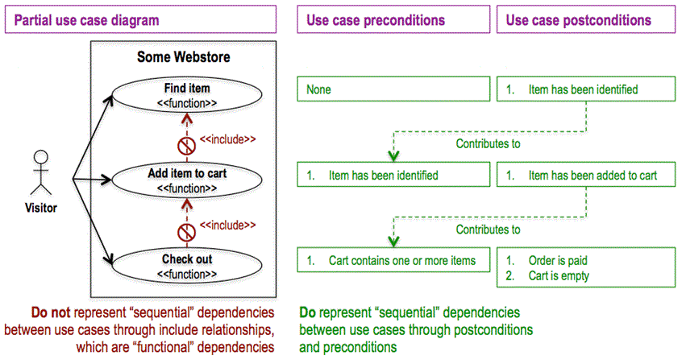

Slide 22
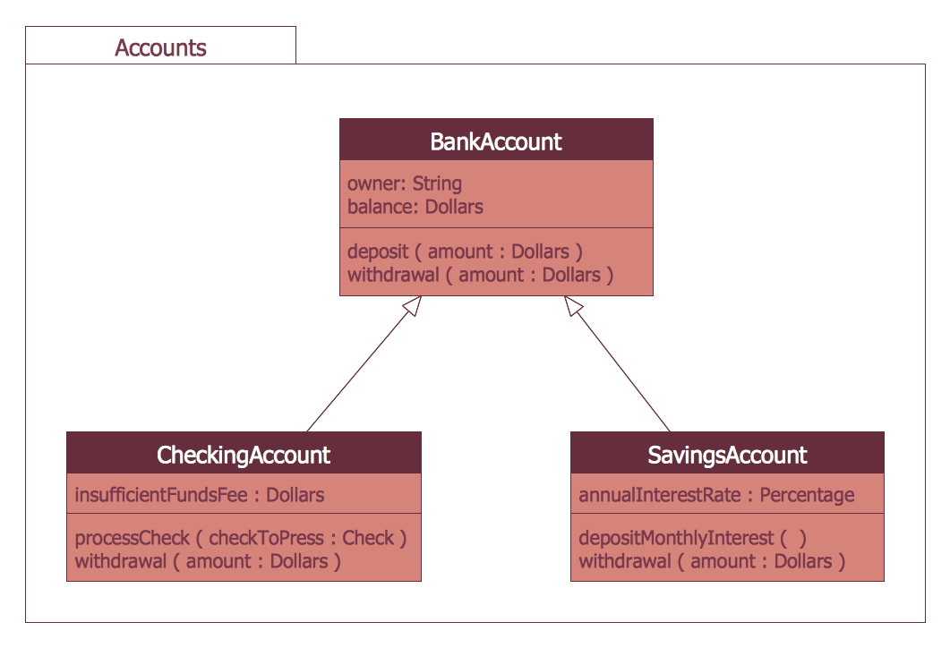
Class Diagram: Inheritence

Slide 23
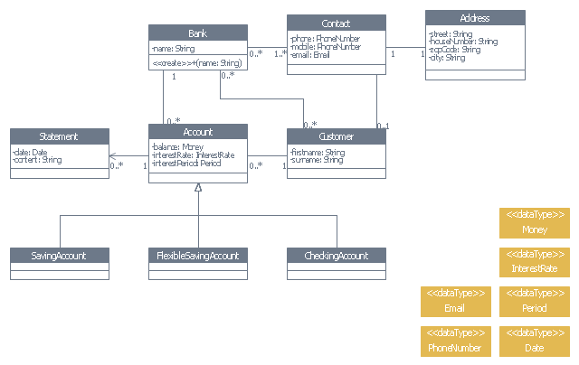
Modelling the larger system

